Slide 1
How can a wellness technology company play it smart ?
BELLABEAT MARCH 2025

Slide 2
Business Task
Analyze smart device usage trends from non-Bellabeat users to uncover insights that can inform Bellabeat’s product strategy and marketing approach, focusing on one specific Bellabeat product to apply these insights effectively.

Slide 3
Data Sources
Sourced from Kaggle (Link).
Provided by Mobius under CC0 Public Domain.
Data from 30 Fitbit users with consent dated.
Tracks activity, heart rate, and sleep and much more.
Using two main data from the dataset – dailyActivity, sleepDay for the time period 12-04-2016 to 12-05-2016
Helps analyze user habits and smart device usage.

Slide 4
Data Cleaning
Removed unnecessary columns and duplicates.
Standardized date formats and handled missing values.
Checked for outliers and sorted the columns according to id.
Created new column in the sleepDay sheet: TotalSleepHours = (TotalMinutesAsleep / 60) SleepEfficiency = (TotalMinutesAsleep/TotalTimeinBed) * 100

Slide 5
Visualizations & Key Findings (spreadsheets)
Sleep efficiency remains high regardless of total sleep hours, but individuals with lower sleep duration tend to have more variability in efficiency.

Slide 6
Visualizations & Key Findings (spreadsheets)
Sedentary minutes dominate daily activity, highlighting a lack of movement for most users, while very active minutes are significantly lower in comparison.

Slide 7
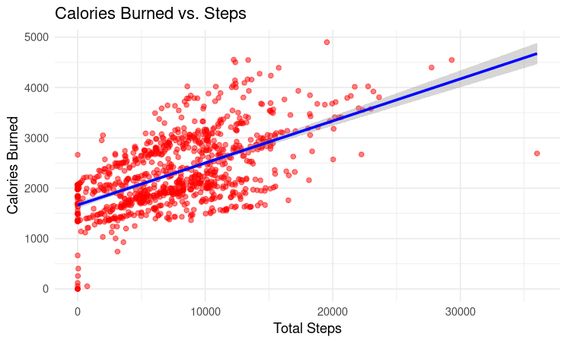
Visualizations & Key Findings (R Programming)
Higher step counts strongly correlate with more calories burned, reinforcing the importance of increased physical activity for better fitness outcomes.

Slide 8
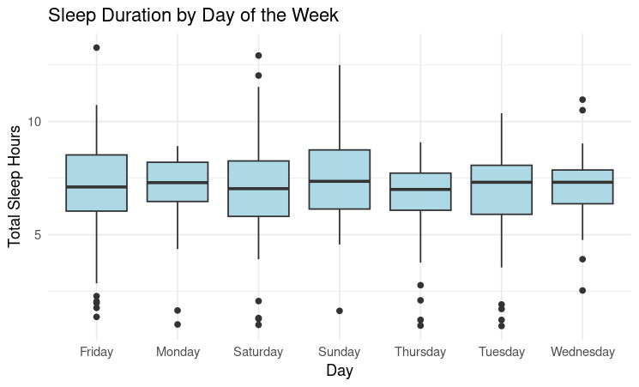
Visualizations & Key Findings (R Programming)
Sleep duration remains fairly consistent across the week, but outliers suggest some users may struggle with irregular sleep patterns.

Slide 9
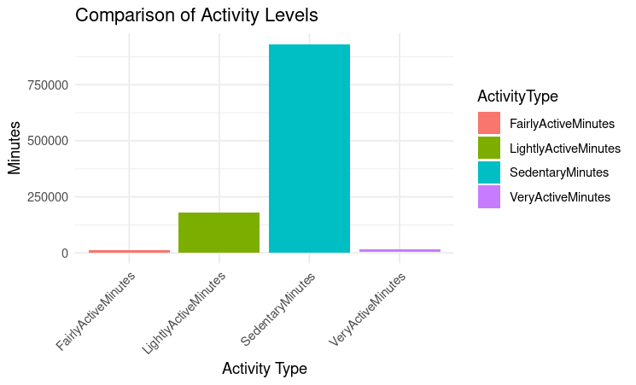
Visualizations & Key Findings (R Programming)
Users spend the majority of their time in sedentary behavior, highlighting the need for targeted engagement strategies to encourage more active lifestyles.

Slide 10
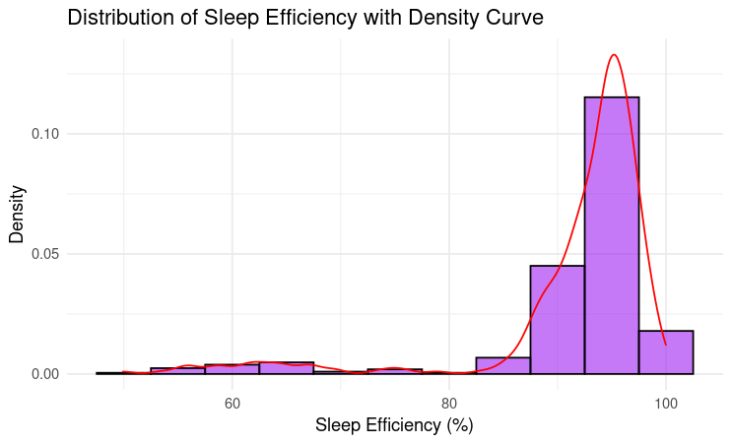
Visualizations & Key Findings (R Programming)
Most users have high sleep efficiency, but a subset experiences lower efficiency, suggesting an opportunity for sleep-tracking interventions.

Slide 11
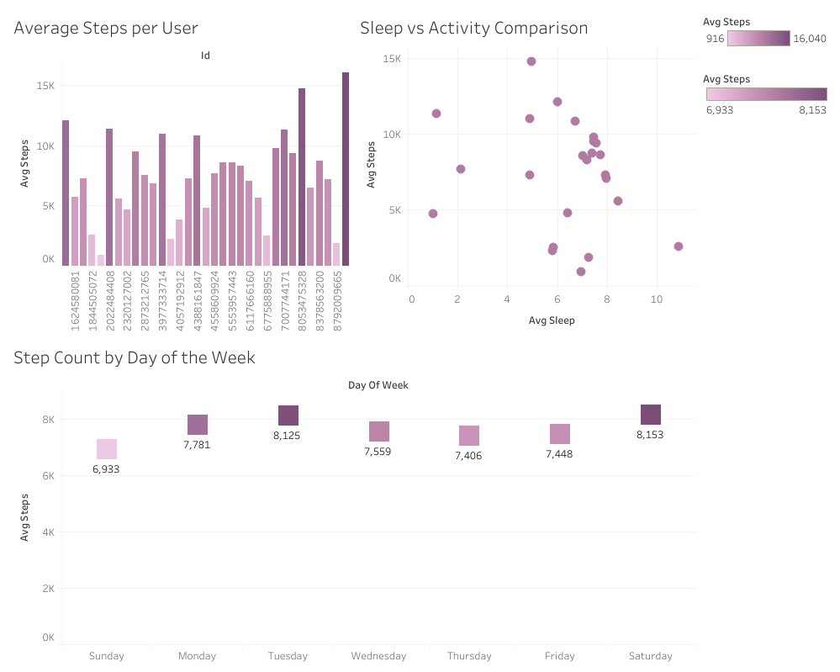
Visualizations & Key Findings (R Programming)
Individual step counts vary significantly, indicating different levels of activity among users.
No strong correlation between sleep hours and step count, suggesting sleep duration does not directly influence physical activity.
Step counts peak on Tuesday and Saturday, implying higher activity levels on these days.

Slide 12
Analysis Summary
The Bellabeat Leaf is the ideal product to focus on, as it aligns with trends observed in smart device usage.
Its ability to track activity, sleep, stress, and reproductive health makes it a strong fit for users aiming to improve their well-being.
Data shows many users struggle with sedentary time, emphasizing the need for movement tracking and inactivity alerts.
Sleep patterns indicate users may benefit from better sleep monitoring and stress management, reinforcing the value of Leaf’s sleep tracking and guided breathing features.
Activity trends reveal that users are most active on Tuesdays and Saturdays, highlighting key opportunities for engagement and product usage.

Slide 13
Recommendations
From Sedentary to Active: Blog post highlighting how Leaf’s features help users move more.
Sleep Smarter: Case study showcasing the benefits of Leaf’s sleep tracking.
Step Up Your Game: Social media campaign encouraging users to stay active.
Work-Life Balance with Wellness Tech: Video content demonstrating how Leaf supports overall wellness.

Slide 14
Further Exploration
How does stress tracking correlate with physical activity levels, and can Bellabeat use this data to provide personalized wellness recommendations?
What percentage of users consistently meet recommended activity and sleep guidelines, and how can Bellabeat encourage better adherence?

Slide 15
Thank you

